Slide 1






Team Innotech
FIFA WOMEN
WORLD CUP ANALYSIS
HOW THE FIFA WOMEN’S WORLD CUP GAME HAS EVOLVED
Outline
Introduction
Dataset Exploration and Cleaning
Visualization
Insights and Recommendations
Start Page

Slide 2
Introduction
Context
Goals for the EDA
Summary of steps
The FIFA Women's World Cup is an international football competition contested by senior women's national teams from FIFA, the sport's governing body. Every four years since 1991, the competition has been held.
To investigate:
How the FIFA Women's World Cup Game has evolved over the years?
The performance of the top and most consistent squads?
The Steps taken are:
Plan drafting
Data Exploration
Data Cleaning
Exploratory Data Analysis
Visualization
Insights and recommendations
Report Writing

Slide 3
Dataset Exploration and Cleaning
Dataset Overview
Key variables
Cleaning and Analysis
The dataset has 136 rows (for observations) and 22 columns (for variables).
The variables are of different data types, including strings, floats, and numerics.
The dataset is ‘messy," i.e., it contains nulls, and the year column has an incorrect data type.
The key variables for analysis are
Squad
Year
Goals
Assist
Possession
Penalty Kicks
Matches Played
The Python programming language was used to handle the data cleaning processes, and steps were documented in a Python notebook. The distribution of each column was visualised to assist in determining how to handle missing values. The unnecessary column present was also removed.

Slide 4
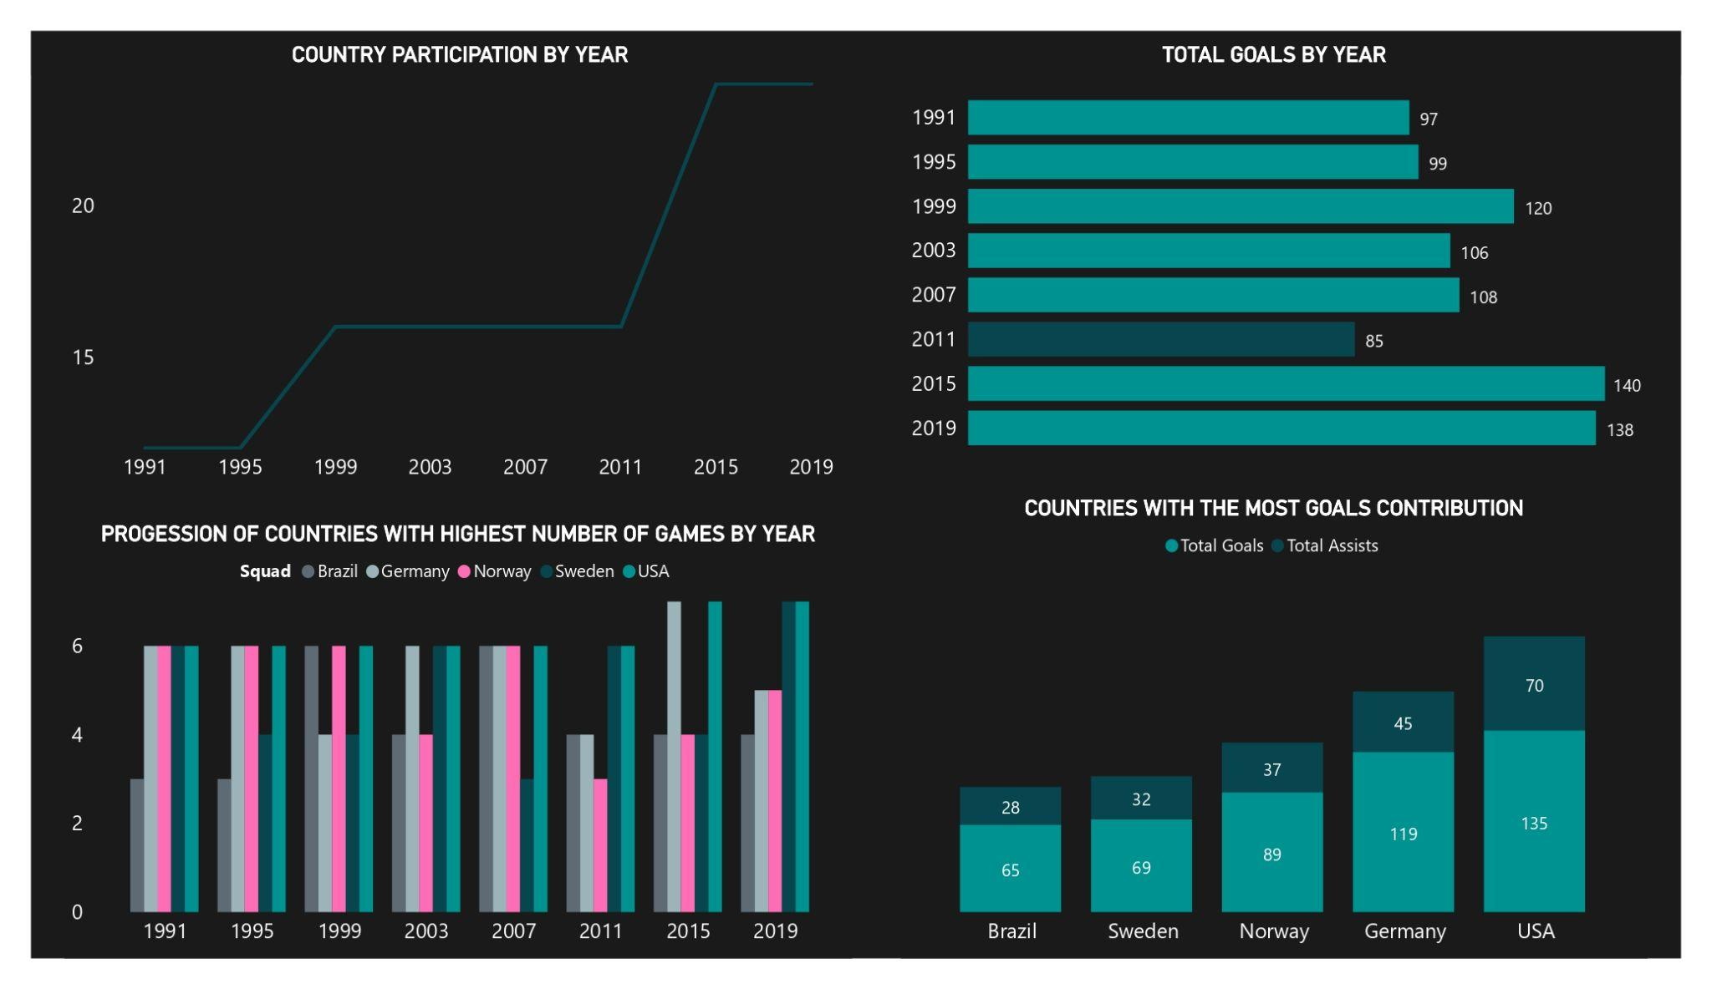
Visualization
PowerBI Desktop was used to derive analytical insights, visualization, and to design the dashboard. Visualisations were made according to the research focus “HOW THE FIFA WOMEN'S WORLD CUP GAME HAS EVOLVED” and insights were derived.

Slide 5
Insights and Recommendations
Insights
Participants have increased significantly with 12 squads in 1991 and 24 in 2019.
The increase in goals over the past year shows that attacking talent is improving.
Over the course of the year, 55 of a total of 63 penalty kicks resulted in goals. The 8 goals missed in 2019 may be a result of some teams' declining efforts to improve their strategy.
USA has dominated the game since 1991, leading in possession, goals and assists.
Teams with larger players (20-23) perform better, with the exception of the Netherlands, who reached the final four with a lean squad of 16 in 2019.
Europe has the most representatives, followed by South America, and Australia has the fewest (2 countries).
Recommendation
There is a need for the inclusion of more and new countries in the Women World Cup.
The squads need to improve their attacking strategy by improving their average possession, assists, and penalty skills.
An increase in the number of players should be considered to enhance the squad's performance.
The playing strategy of the US should be understudied by other squads to enhance their game.
Experience and age should be taken into account in team selection.

